Slide 1


Web Development Back-End
Client-Server
HTTP

Slide 2
Client-Server Communication
Client – User’s PC
Navigate Internet
Ask for services
Server – Another PC somewhere on the Internet
Provide web pages
Provide services

Slide 3
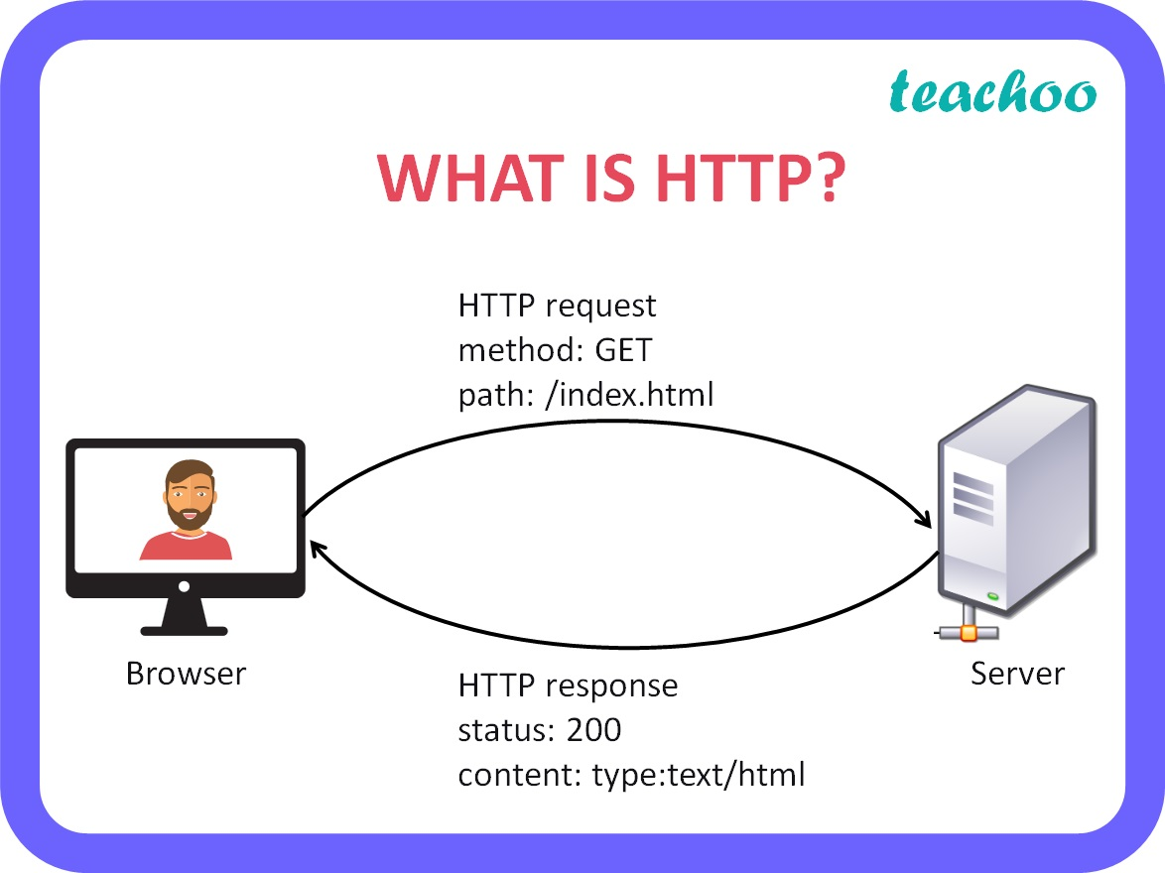
Client-Server Communication
Both identified by an IP Address
Communicate with HTTP
Hyper Text Transfer Protocol
Commonly used for:
Loading webpages and resources
Starting server processes
Interacting with a server’s database
Everything related to a server!

Slide 4
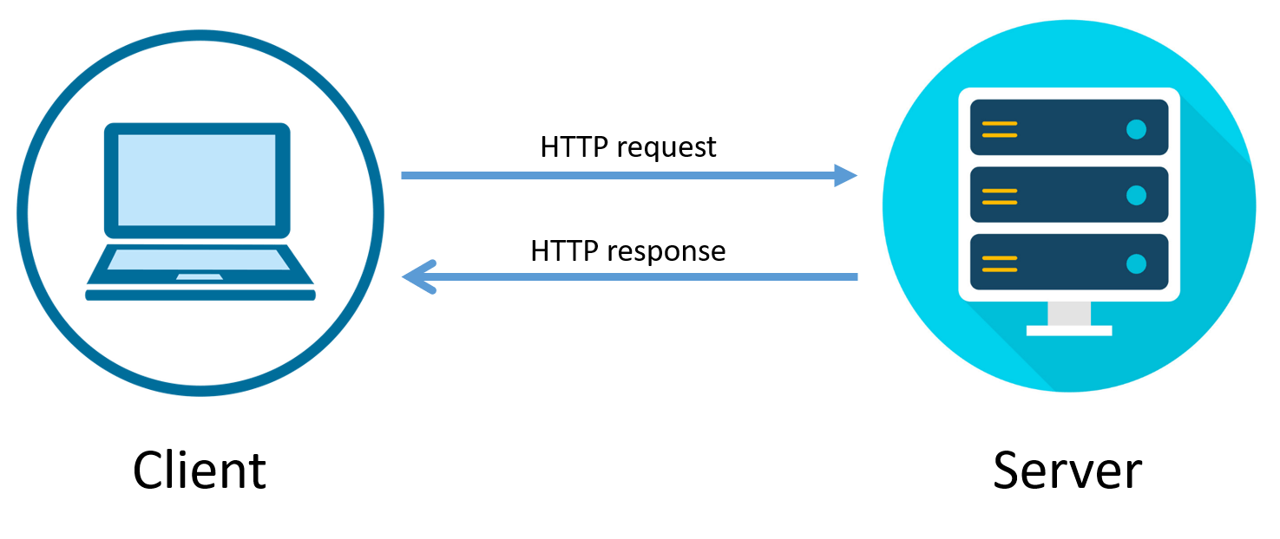
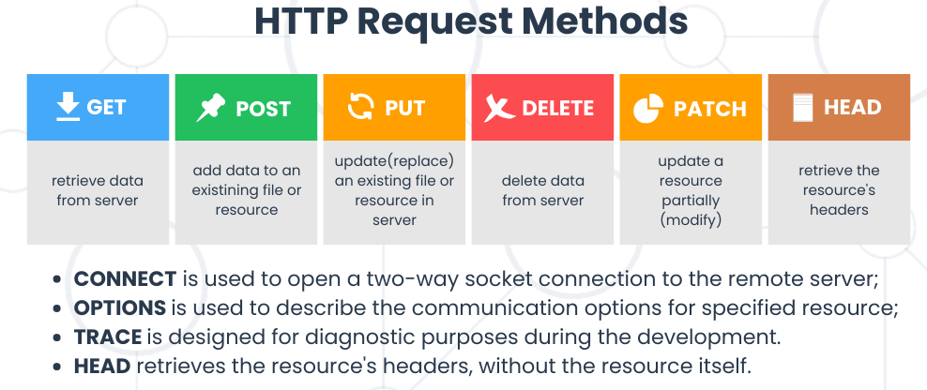
HTTP – Request and Response
Request – Ask server to do something
Ex. Get an article, login a user, send an email, start a live chat
Method – Category of communication
https://www.w3schools.com/tags/ref_httpmethods.asp

Slide 5
HTTP – Request and Response
Request – Ask server to do something
Headers – Metadata about the request
Common headers:
Content-Type: Indicate body data format (text, JSON, binary, etc.)
Authorization: Credentials for authentication the client user
Cookie: Sends stored cookies to the server
Accept-Encoding: Indicate acceptable data encoding
Clear-Site-Data: Clear cookie, storage, and/or cache
User-Agent: Info about client's browser, OS, and device
https://www.w3schools.com/tags/ref_httpmethods.asp

Slide 6
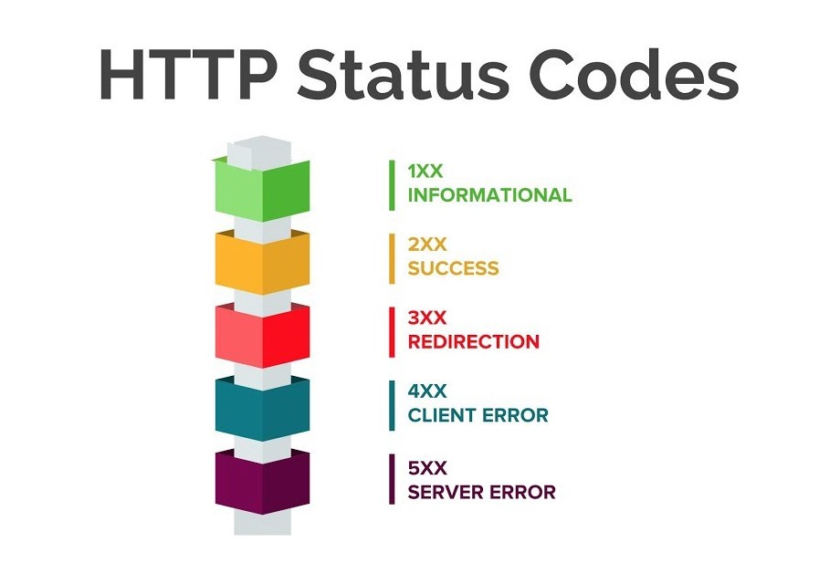
HTTP – Request and Response
Response – Let client know how it went (including sending data if needed)
Ex. send the requested article, authenticate the user credentials and send an auth token, mail the requested email, send an address to connect to live chat
Status Code – Indicate outcome category
Common Codes:
200 – OK (Success)
201 – Created
301 – Moved Permanently
401 – Not Authorized
404 – Not Found
500 – Internal Server Error
503 – Service Unavailable
https://gist.github.com/sandrabosk/d125177b31eca8dc3e5c524e703ba94d

Slide 7
HTTP – Request and Response
Response – Let client know how it went (including sending data if needed)
Headers – Metadata about the response
Common headers:
Content-Type: Indicate response data format (text, JSON, binary, etc.)
Set-Cookie: Send back a cookie
Encoding: Indicate data encoding format
Server: Info about the server software
Expires: Date and time the response should be considered stale
CORS (Cross-Origin Resource Sharing) headers:
Access-Control-Allow-Origin: Let different domains communicate
Access-Control-Allow-Credentials: Indicate credentials for CORS
Access-Control-Allow-Methods: Allow certain HTTP methods
https://developer.mozilla.org/en-US/docs/Web/HTTP/Headers
https://www.youtube.com/watch?v=4KHiSt0oLJ0&ab_channel=Fireship

Slide 8




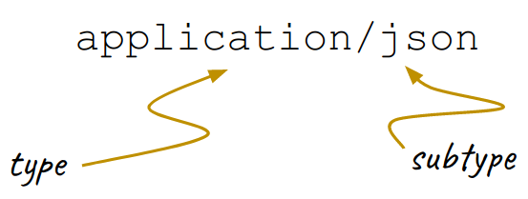


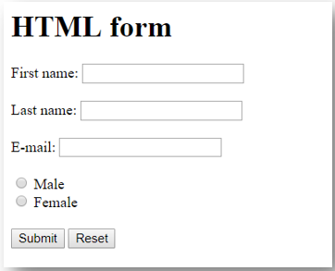
HTTP – Sending Data
Various Kinds of Data to Send
Indicated by the content-type header in the request/response
Based on standard MIME types:
https://developer.mozilla.org/en-US/docs/Web/HTTP/Basics_of_HTTP/MIME_types/Common_types
https://developer.mozilla.org/en-US/docs/Web/HTTP/Basics_of_HTTP/MIME_Types#important_mime_types_for_web_developers
form-data

Slide 9
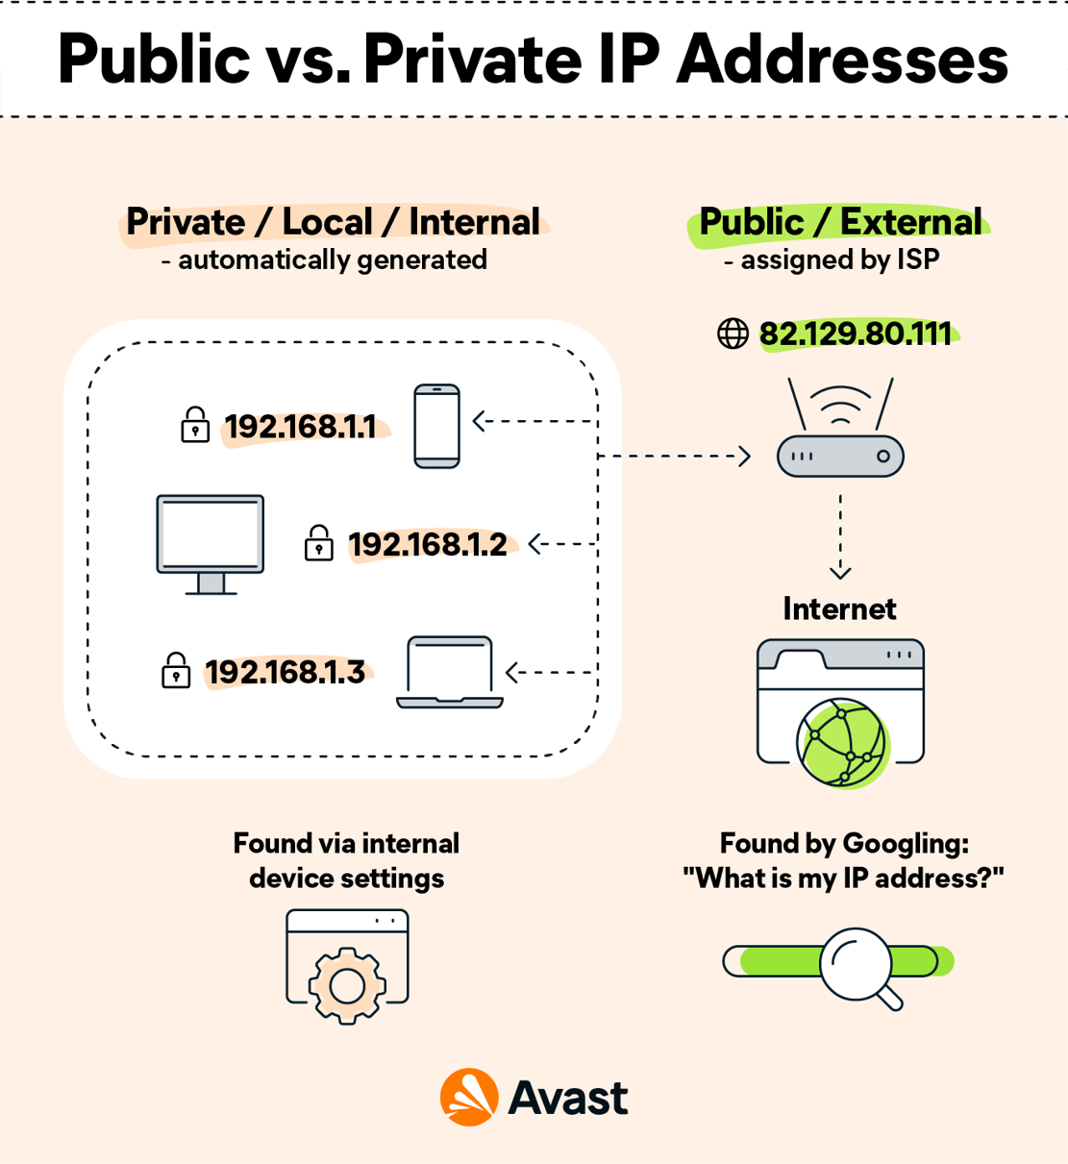
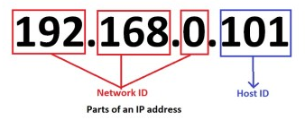
Internet Protocol (IP) Address
Unique address of a computing device on a network
Private IP Address
Available only on the local network (home, school, office, etc.)
Public IP Address
Used to communicate across the global Internet

Slide 10
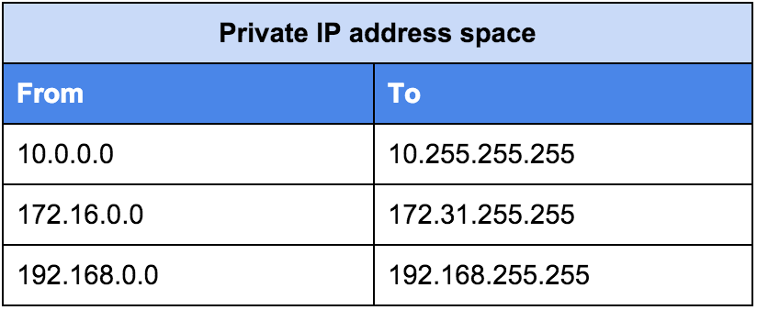

Internet Protocol (IP) Address
The Internet Assigned Numbers Authority (IANA) reserved certain IP address pools for private network use:
In IPv4, each # is 1 byte (0 – 255) range
Public IP Address
Assigned to your device by your Internet Service Provider (ISP)

Slide 11
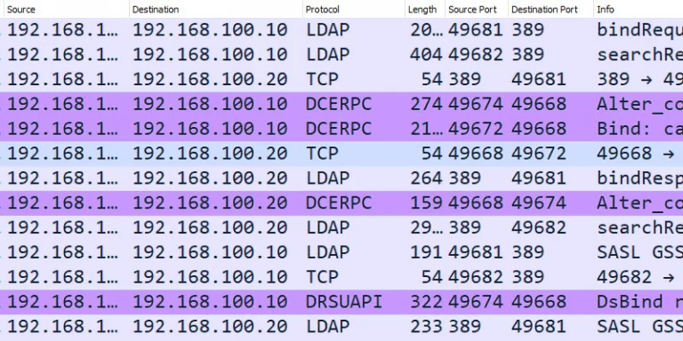
Port
Direct network traffic to the correct process or application on a host
Well-known ports
HTTP: 80 (8080)
HTTPS: 443 (4430)
FTP: 21
SSH: 22
Telnet: 23
Email SMTP: 25 (2525)
Secure email: 993 / 995

Slide 12
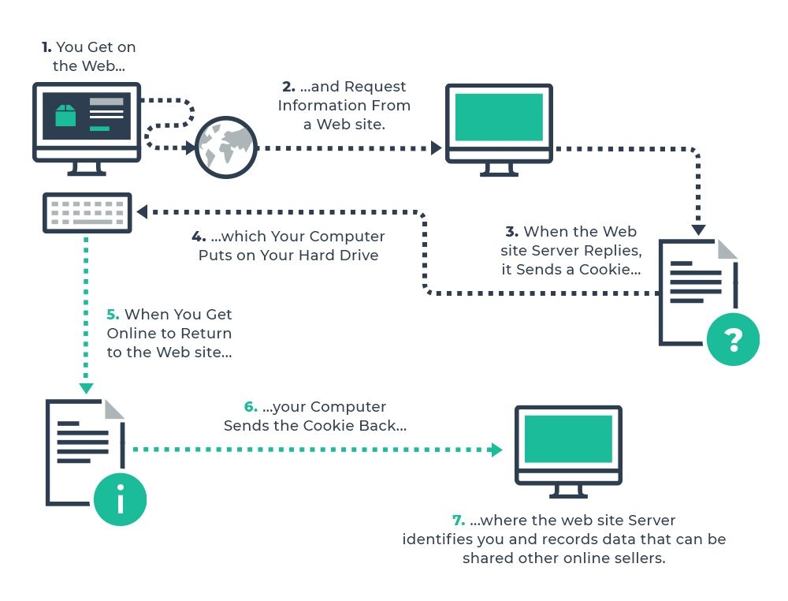
Cookies: keeping “state”
https://www.youtube.com/watch?v=GihQAC1I39Q&ab_channel=WebDevSimplified

Slide 13

HTTP and HTTPS
HTTP is not secure!
All data is sent as plain-text (even POST request bodies)
Intercepted data is vulnerable
Man-in-the-middle attack, Session hijacking, phishing, etc.
HTTPS – HTTP Secure
Encrypts all data with Secure Sockets Layer (SSL) or Transport Layer Security (TLS)

Slide 14
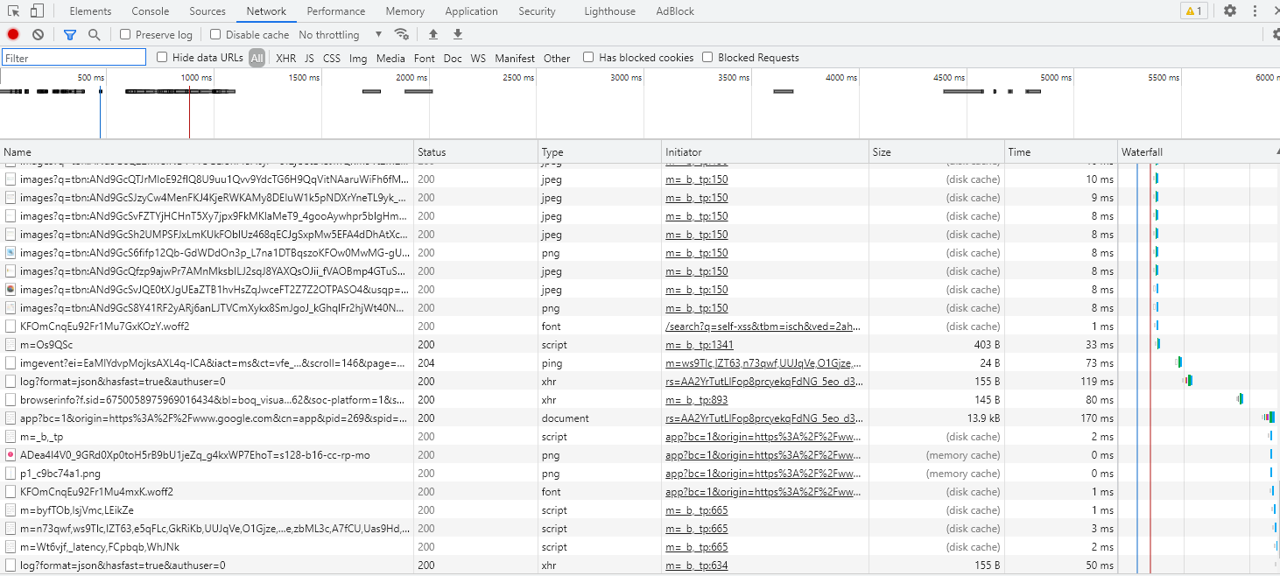
See HTTP in Action
Chrome Developer Tools → Network

Slide 15
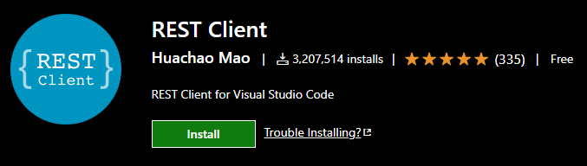
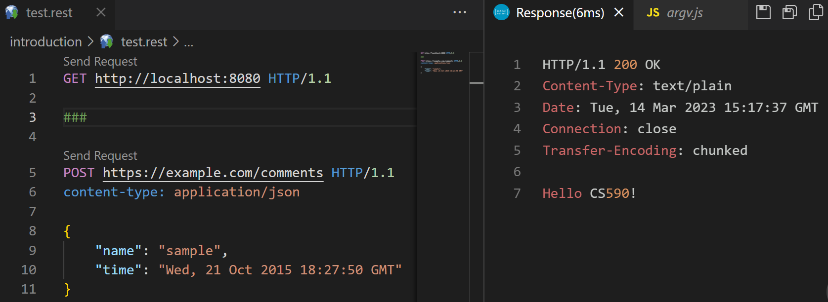
HTTP Tools: RestClient – VSCODE Extension
Simple, convenient in-IDE HTTP tool
Create .rest or .http file with various HTTP requests that can be activated on click

Slide 16

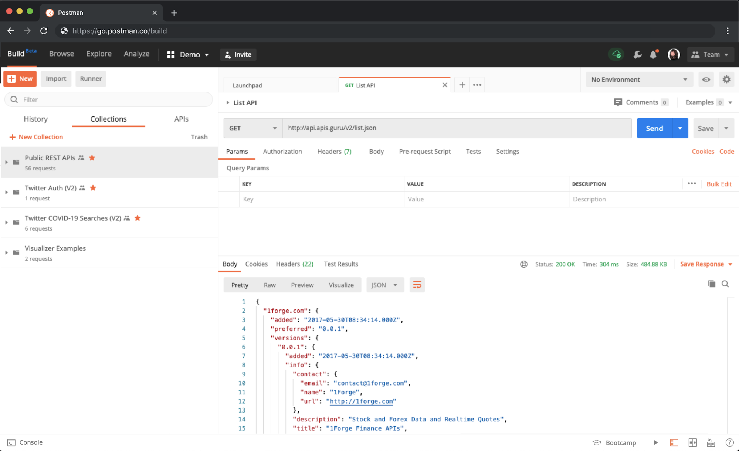
HTTP Tools: Postman – API Platform
Larger, feature-rich API tool
API development, testing, and debugging.
GUI-based API management
Code snippet generation
Scripting for API workflows and testing
Mock servers
Team collaboration

Slide 17
HTTP Practice
Create the following two HTTP Requests in a .rest file, using Postman, or in a .sh file using cURL:
A GET request to https://www.wikipedia.org/
A POST request to localhost on port 3000 to route /createpost that sends JSON data with title and body fields

Slide 18
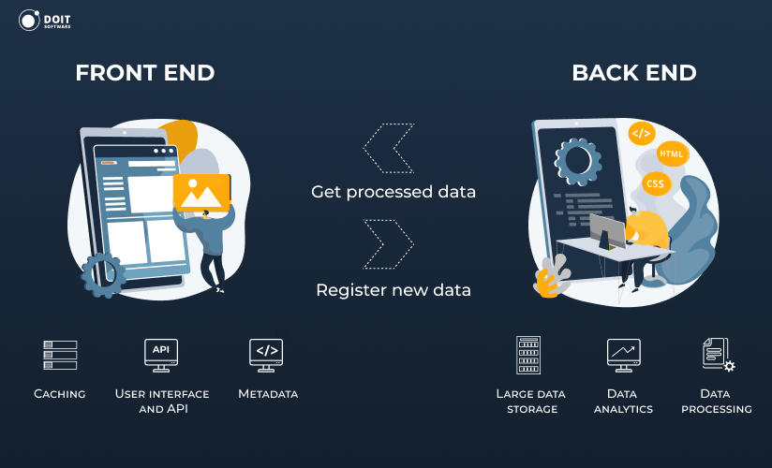
Server-Side (Back-End)
Client-Side Limitations
No File I/O
No database access
Client-side code is viewable by anyone
Processing can be slower (defined by user’s machine)
These things can be done on the server (back-end)!

Slide 19
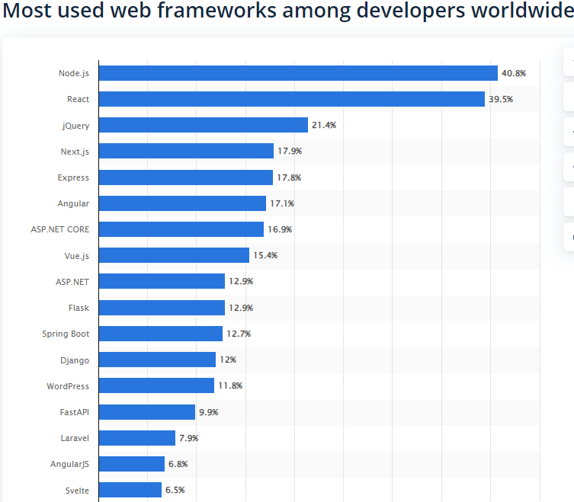
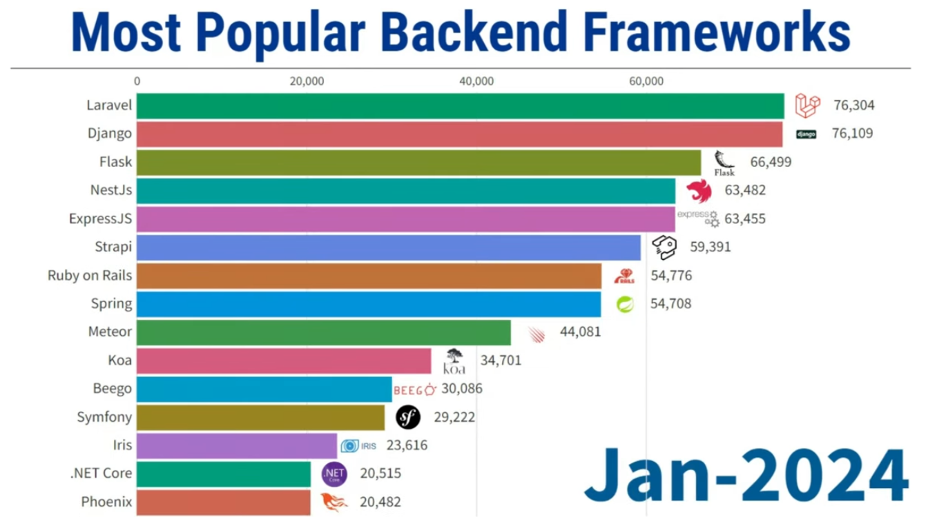
Back-End Frameworks
Web back-end has many technology/framework options

